Slide 1


College of Agriculture, Health and Natural Resources
TITLE
NAME
DATE/CONTACT INFO

Slide 2
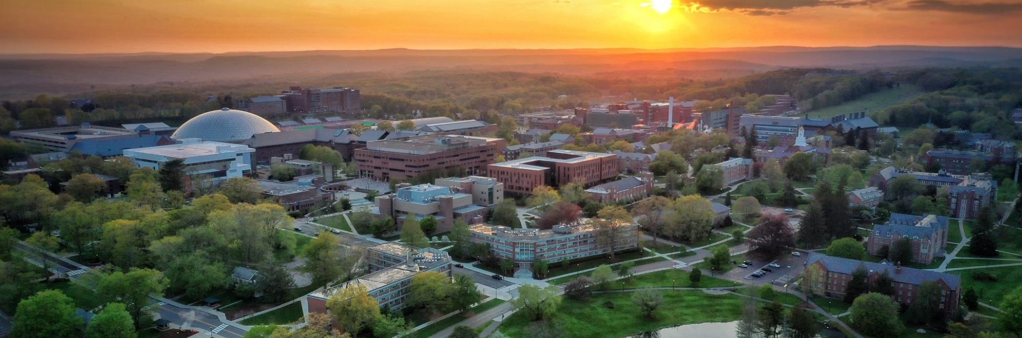
College of Agriculture, Health and Natural Resources
TITLE
NAME
DATE/CONTACT INFO

Slide 3

College of Agriculture, Health and Natural Resources
TITLE
NAME
DATE/CONTACT INFO

Slide 4

College of Agriculture, Health and Natural Resources
TITLE
NAME
DATE/CONTACT INFO

Slide 5

College of Agriculture, Health and Natural Resources
TITLE
NAME
DATE/CONTACT INFO

Slide 6
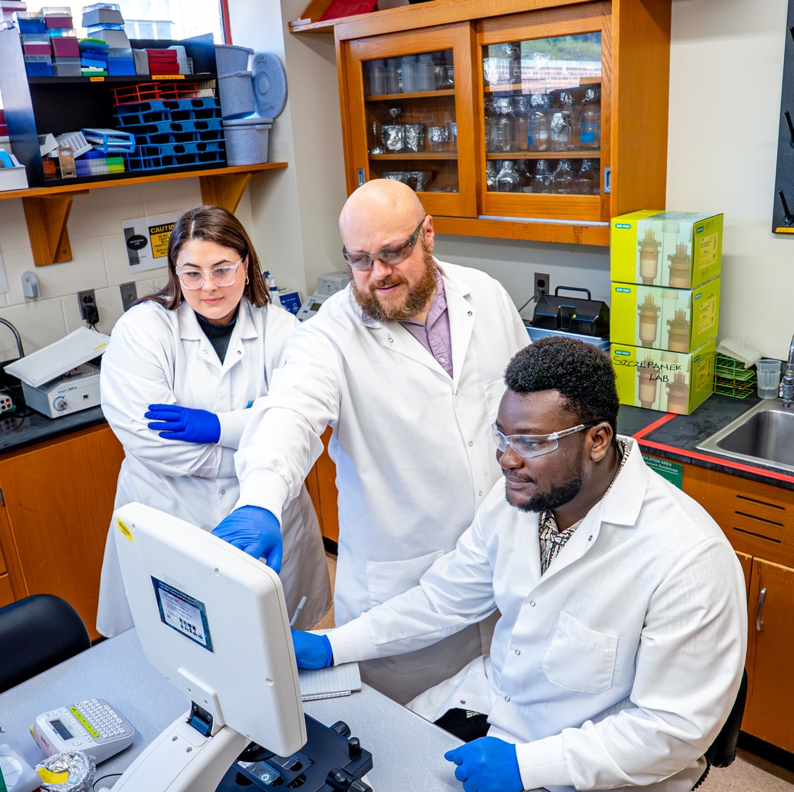
College of Agriculture, Health and Natural Resources
TITLE
NAME
DATE/CONTACT INFO

Slide 7

College of Agriculture, Health and Natural Resources
TITLE
NAME
DATE/CONTACT INFO

Slide 8

College of Agriculture, Health and Natural Resources
TITLE
NAME
DATE/CONTACT INFO

Slide 9
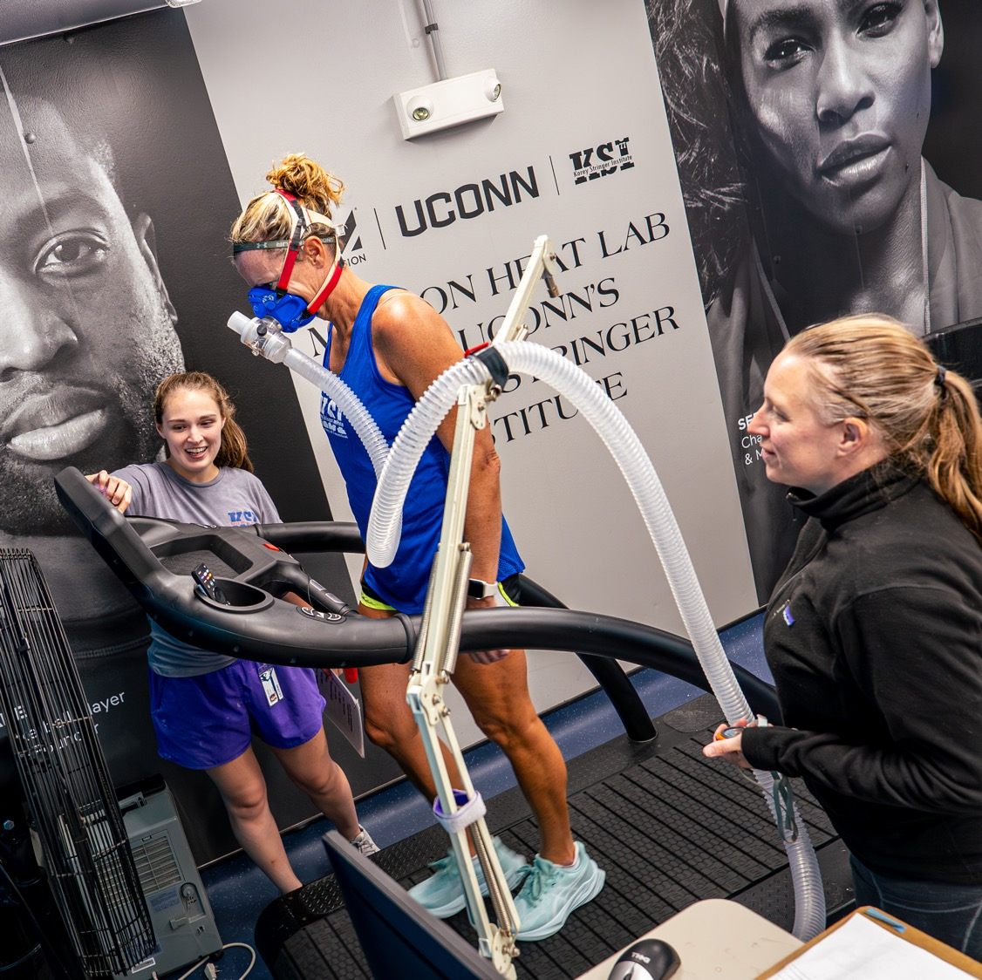
College of Agriculture, Health and Natural Resources
TITLE
NAME
DATE/CONTACT INFO

Slide 10
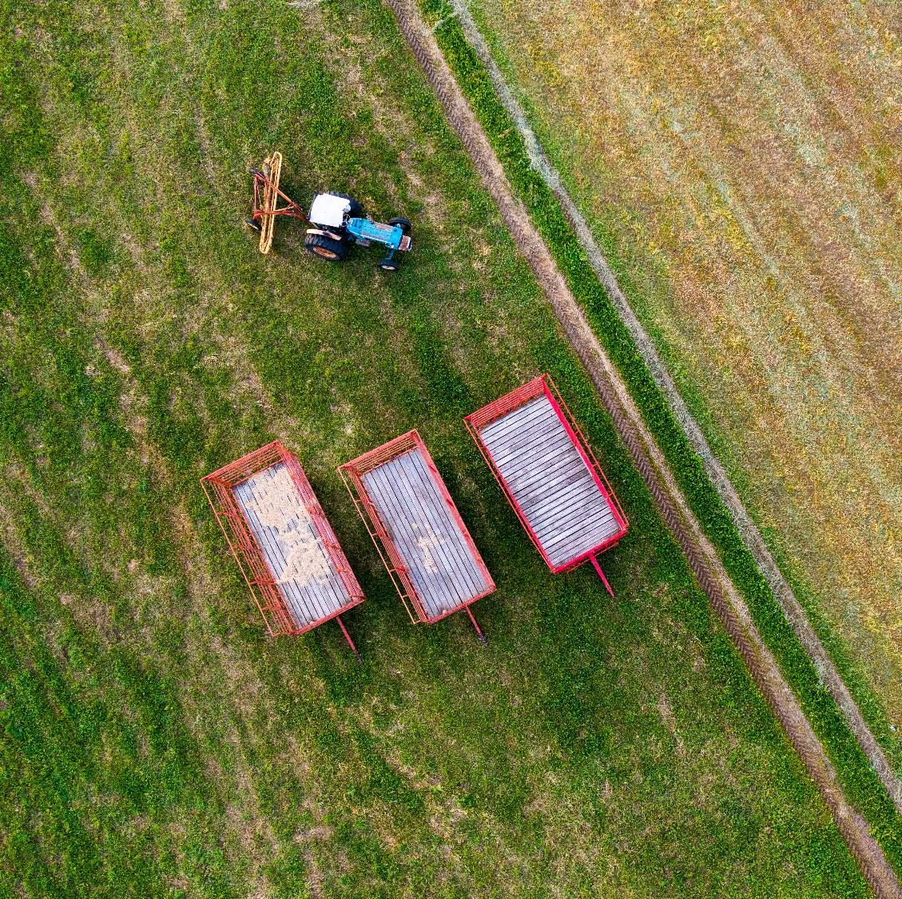
College of Agriculture, Health and Natural Resources
TITLE
NAME
DATE/CONTACT INFO

Slide 11
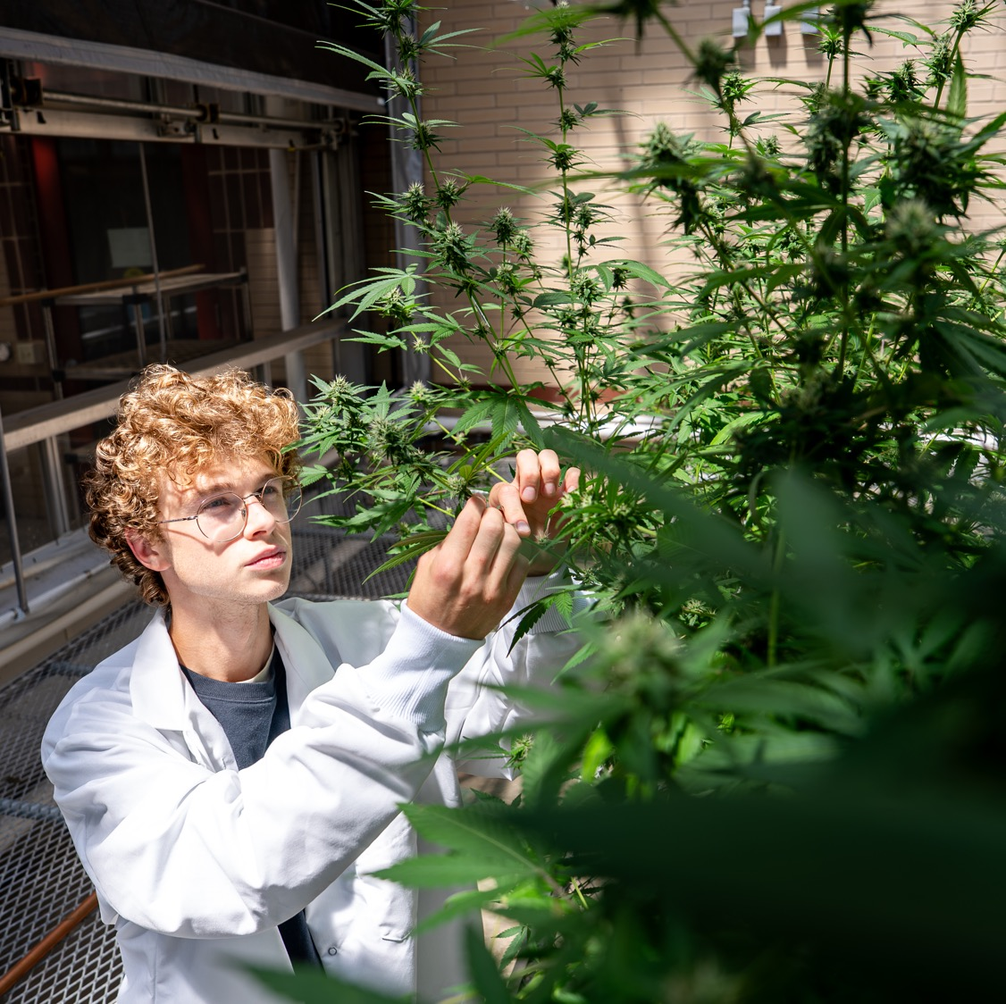
College of Agriculture, Health and Natural Resources
TITLE
NAME
DATE/CONTACT INFO

